Slide 1

Graduate student services at USC

Slide 2
Student services programming
Support for graduate students from campus partners for:
Career Development
Communication & Professional Development
Financial Wellbeing
Health & Wellness
Leadership, Service & Teamwork
Scholarly Development
Teaching and Learning

Slide 3

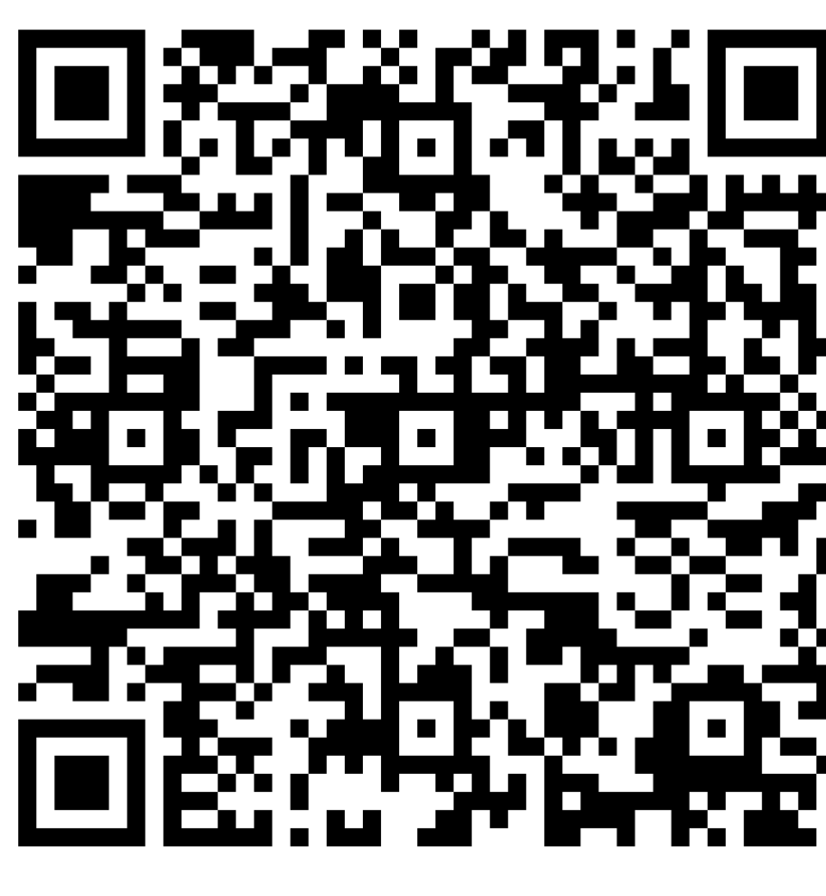
Graduate Student Expo 2025
Connect with fellow graduate and professional students across disciplines
Discover over 30+ campus resources and organizations
Learn through informal breakout sessions and helpful workshops
Win door prizes like $500 tuition supplements, parking passes, gift cards, and more!

Slide 4
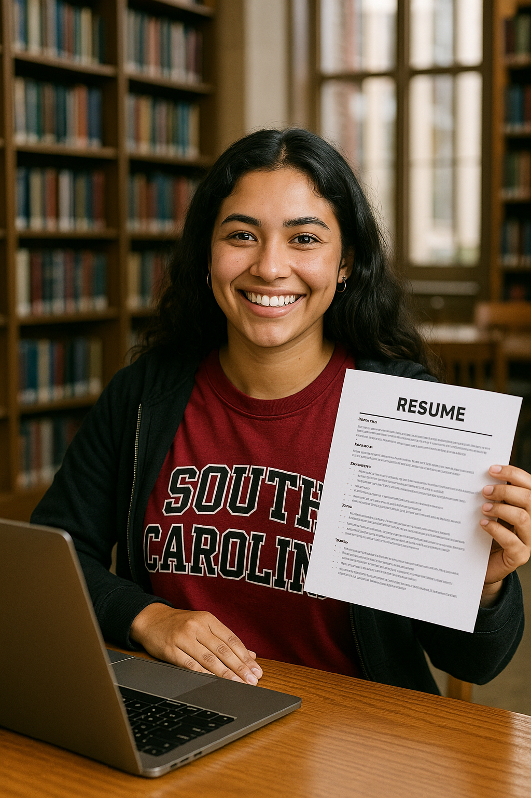
Supporting Your Success:
University Career Center
Guide master’s and Ph.D. students in exploring careers in academia, industry, nonprofits, and more
Empower students to build confidence through career discussions and personalized plans
Help translate research, teaching, and leadership into resumes, CVs, and interview stories

Slide 5
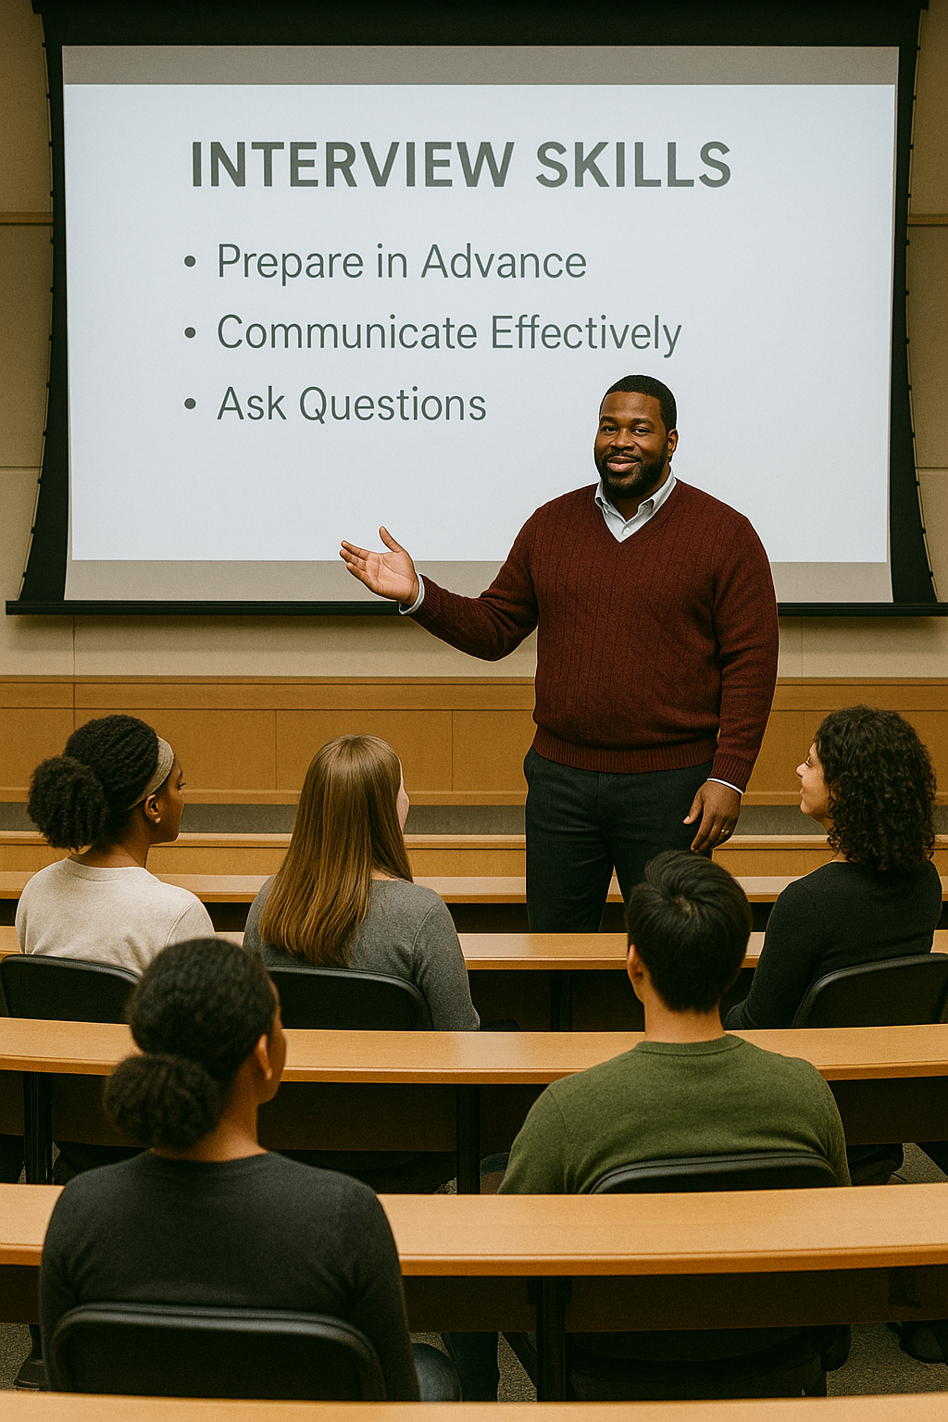
Personalized Guidance for Your Goals
Individual advising on academic planning and career pathways
Resume, CV, and cover letter reviews with targeted feedback
Interview prep and mock interviews with performance feedback
Career exploration to identify roles and industries
Establishing Job search strategies
Networking training and personal/professional branding
Guidance on turning academic experiences into marketable skills

Slide 6
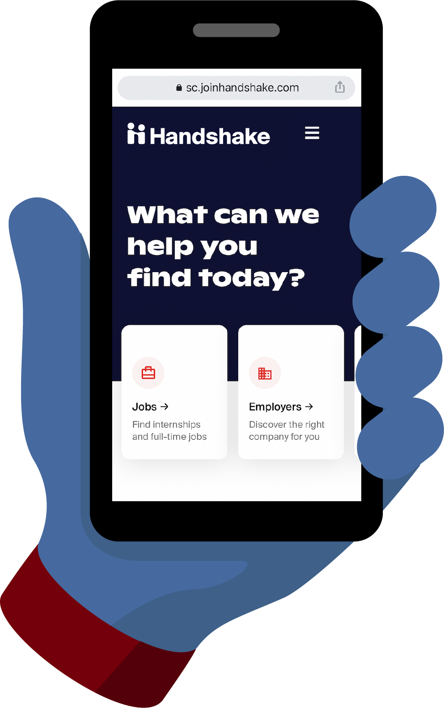

Handshake coaching, Education, and opportunities
Online career management platform
Search for student employment, internships, co-ops, jobs, federal work study positions, graduate assistantships
Register to attend career fairs and events to connect with employers
Schedule appointments with a Career Coach
Notes:
Handshake If you are looking to earn money while in school, we encourage you to seek on-campus student employment. The best way to find internships and on-campus student employment, including federal work study jobs, is to visit Handshake. Handshake is USC’s career management platform where you can search for jobs as well as register for various in-person and virtual career fairs and events with employers. Also, Handshake is where you can make appointments with your career coach. You’ll want to activate your Handshake account as soon you get to USC to get your career started.

Slide 7
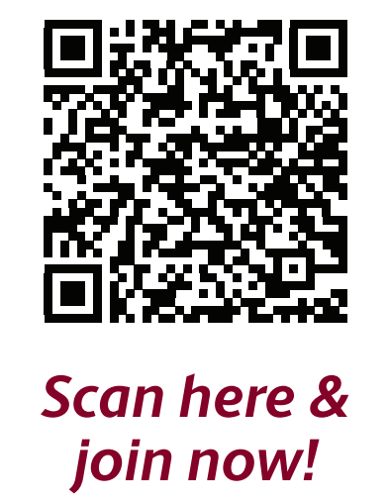

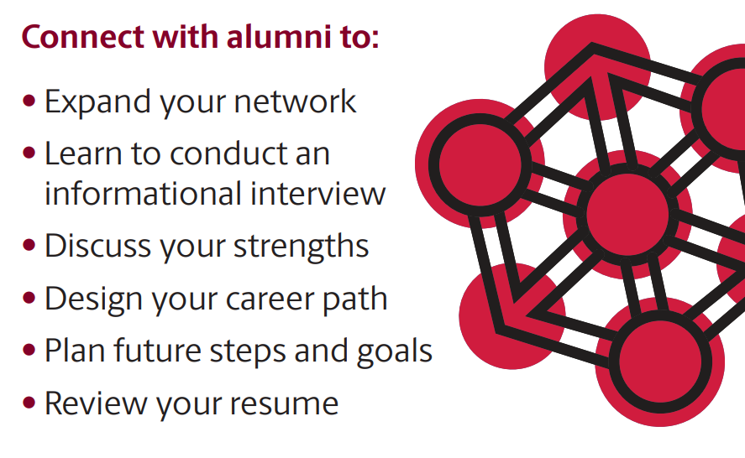
University career center

Slide 8
Graduate School
Resources for new graduate students
  Recorded sessions covering campus resources, thriving as an online student, and more
Professional development resources
Professional development workshops
  Writing research proposals in different disciplines
  How to communicate your scholarly identity and research agenda
  Planning and executing a personal development plan
Dissertation Writing Academy

Slide 9
Graduate school
Communicating and presenting research
  Discover USC
    Annual research symposium (April 26, 2026)
  Three Minute Thesis (3MT)
    Takes place each fall (expected early November)
    $1000 prize for winner
  Graduate School travel grants
    Supports travel to present work domestically and internationally
    Three cycles per year

Slide 10
Student Success Center
Grad Student Support – 1-on-1 Consultations
Success Consultations
  Planning Toward Your Goals
  Managing Your Time in Grad School
  Managing Your Reading Load
  Relearning How to Learn
  Managing Your Writing Process
Money Management Consultations
  Basic Budgeting
  Financial Apps and Resources
  Planning for Loan Repayment
  Understanding Credit and Debt
  Accountability Groups
  Weekly recurring small group meetings with a dedicated facilitator to promote independent work and community building in a structured, goal-oriented environment.

Slide 11
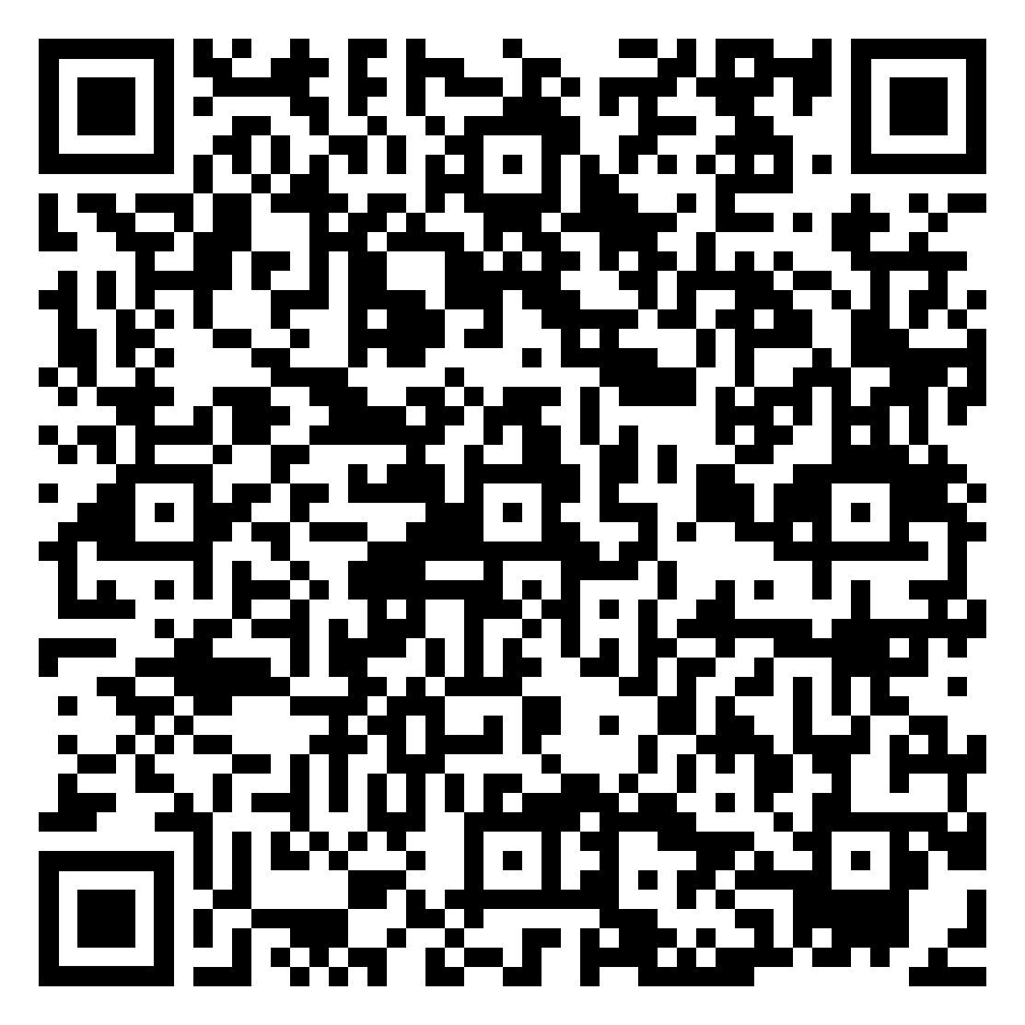
Student success center Grad SUpport
Schedule one-on-one appointment
Sign up for an accountability group
Upcoming Workshops
  Building Your Grad School Toolkit
    Sept 11th
  Managing Your Time in Grad School
    October 14th

Slide 12
Other offices dedicated to your success
Carolina Grants and Innovation Hub
Center for Integrative and Experiential Learning (CIEL)
Center for Teaching Excellence (CTE)
International Student and Scholar Support
National Fellowships
Student Disability Resource Center
Student Health and Wellbeing
University Libraries

Slide 13
Additional Graduate student professional development at usc
CIEL grants
  Carolina Engage Grant, Beyond the Classroom Grant
CTE certificates
  Mentoring, AI, inclusivity, and more
Data Analysis and Statistics Services
  One-on-one support for help with research data
SHARPGrads
  Digital scholarship, computing, and research training
Writing Center consultations

Slide 14
Confidential help
Office of Student Advocacy
  Confidential help navigating university policy
  Referrals to campus resources
  studentadvocacy@sc.edu
Basic Needs Referral
Gamecock CommUnity Shop
  Carolina Coliseum, Suite 4000
  Gamecock Pantry
  Carolina Closet
Gamecock School Supply Closet
  Student Success Center
    Mezzanine of Thomas Cooper Library
Garnet Bites
  Notifications of available food on campus
Carolina Cares Fund
  Financial help for unexpected emergencies

Slide 15
Contact us
Graduate School
Matt Klopfenstein
Director of Professional Development
klopfenm@mailbox.sc.edu
University Career Center
Nigel Smith
Manager, Graduate Student Advising
ns23@mailbox.sc.edu
Graduate School
Kesha Clavon
Director of Recruitment and Student Affairs
kesha@mailbox.sc.edu
Student Success Center
Josh Dunn
Assistant Director for Graduate Student Support
dunnjc@mailbox.sc.edu

